Slide 1
CHANGES AROUND US
Note: For better understanding, this ppt should be used synchronously with the audio file attached.
Class : VI ^{TH} SUBJECT : SCIENCE
CHAPTER 6
MODULE I

Slide 2
Lets have FUN!
Imagine; what if you get some magical powers to change things around you. What are the things you would want to change?

Slide 3
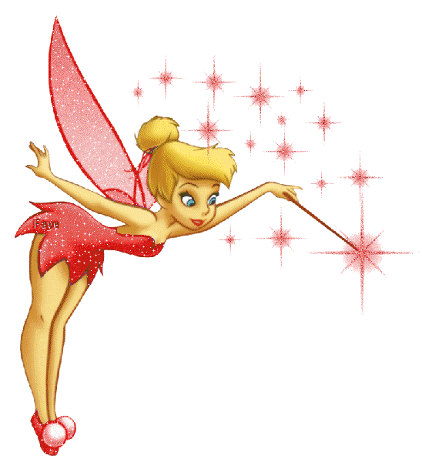
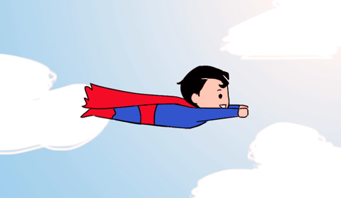
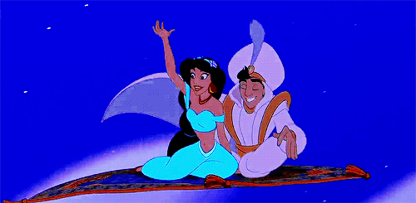
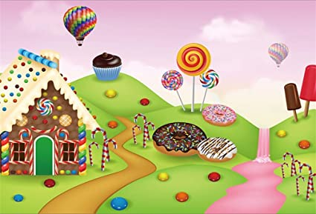
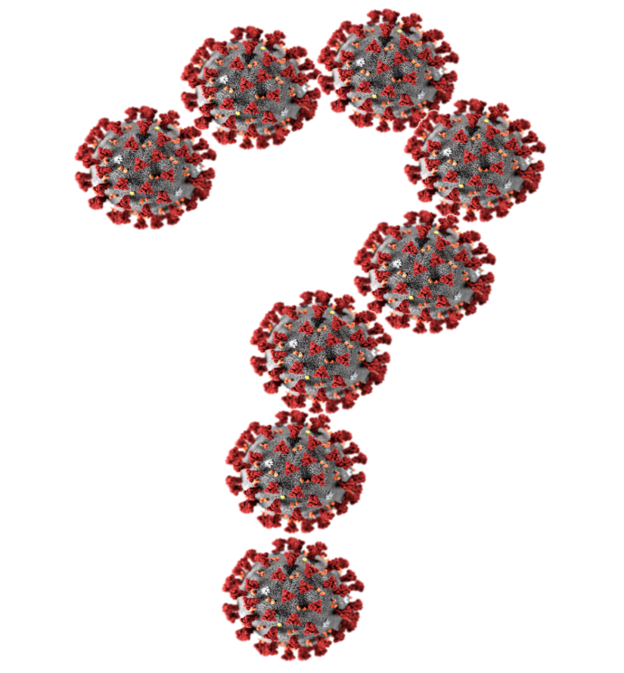
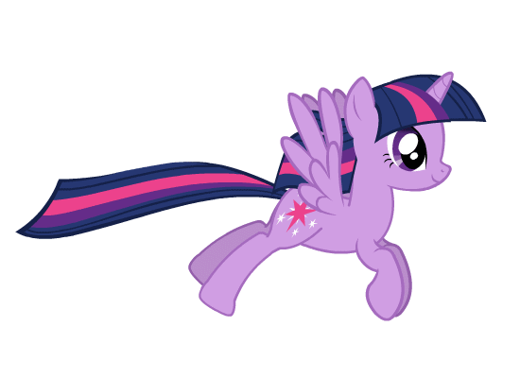
These are some of the things you would like to change
●

Slide 4
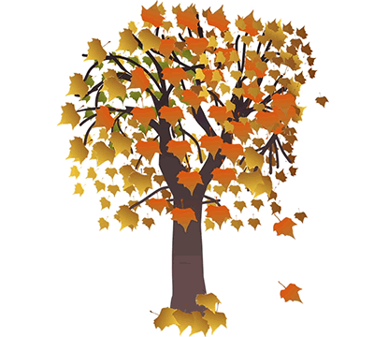
Changes that take place on their own

Slide 5
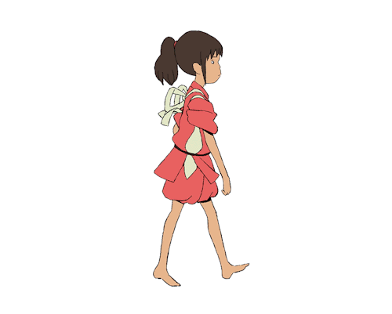
Changes happening in your body
You grow in height.
Your nails and hair grow.
Your weight increases as you grow.
Your voice changes.

Slide 6
Can these Changes be grouped together
Slow & fast changes
Periodic & Non- periodic changes
Reversible & Irreversible changes
Physical & Chemical changes

Slide 7
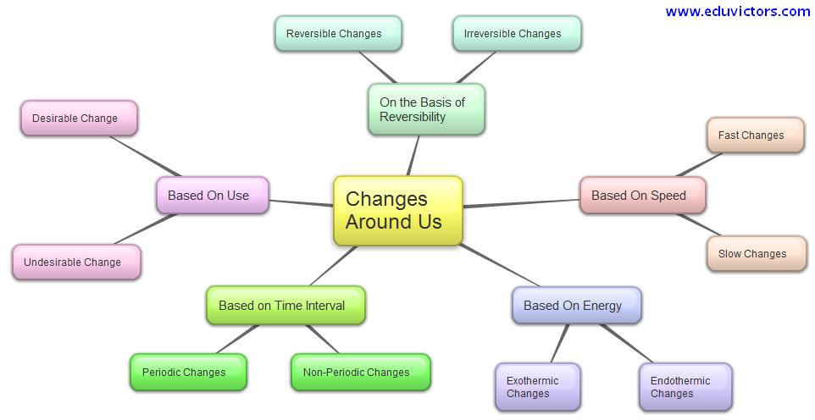
Different classification of changes around us

Slide 8
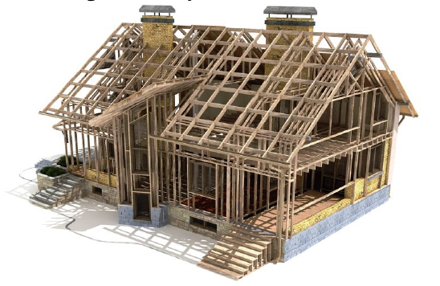
Slow Changes
These are the kind of changes that will happen over a long period of time slowly. For instance, a boy becoming a man, construction of a house, ripening of fruits, growing of plants etc.

Slide 9
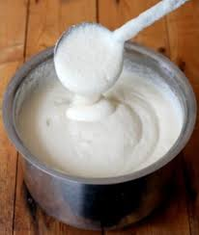
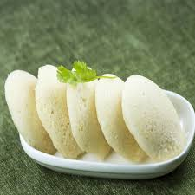
Fast Changes
As the name suggests, these changes occur sooner than the other. For instance, a batter turning into idlis (It will take hardly a few minutes for a liquid batter to turn into idlis.), bursting of crackers, blinking of eyes, switching on light/ fan etc.

Slide 10
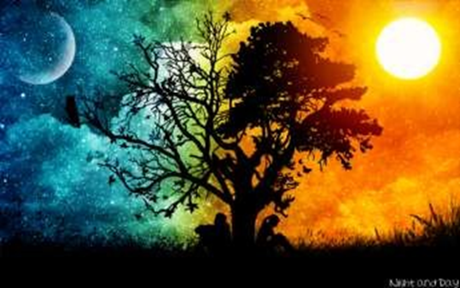
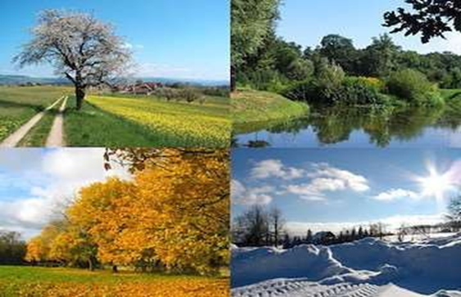
Periodic Changes
Changes which repeat themselves after a regular interval of time are called periodic changes. Day and night, phases of the moon, change in seasons etc are the examples of periodic changes.

Slide 11
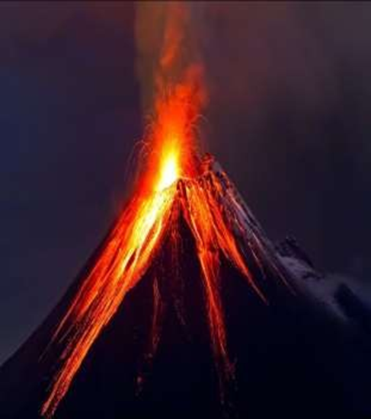
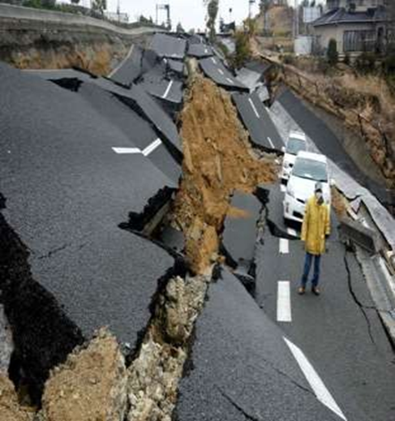
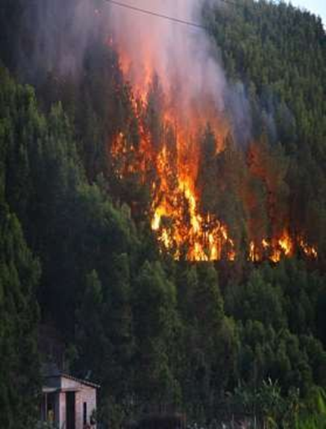
Non-periodic Changes
Changes which do not occur on regular intervals of time are called non-periodic changes. For example eruption of volcanoes, earthquakes, forest fire etc. are non-periodic changes.

Slide 12
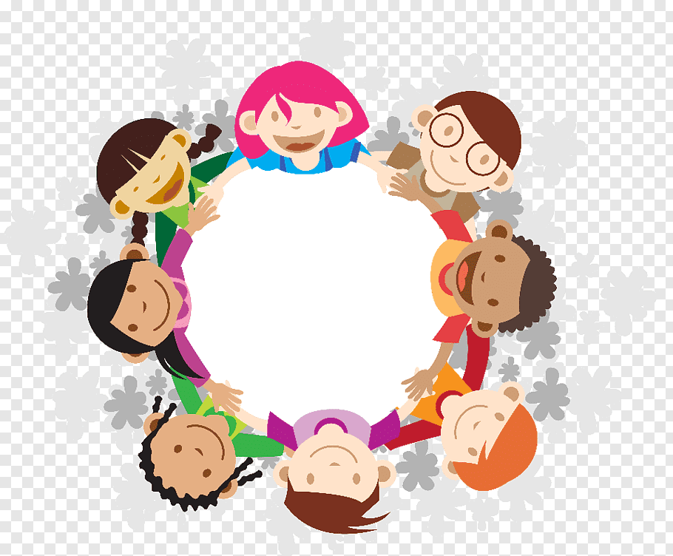
What are reversible and irreversible changes?
ACTIVITY

Slide 13
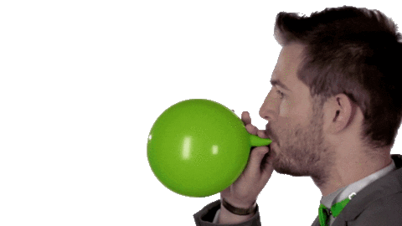
BLOWING OF A BALLOON
Activity 1

Slide 14
FOLDING A PAPER TO MAKE TOY AEROPLANE
Activity 2

Slide 15
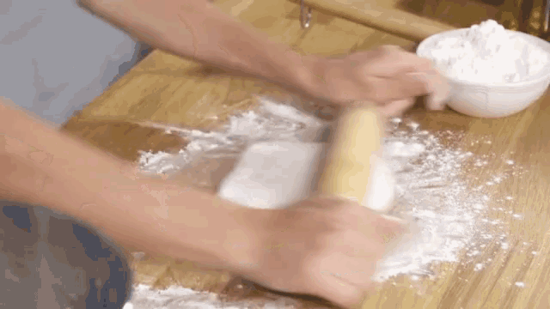
ROLLING A ROTI FROM A BALL OF DOUGH
Activity 3

Slide 16
NOW ANSWER
Was it possible to get the balloon back to its original shape and size?
Was the size of the paper same as before and after making an aeroplane ?
Was it possible to get back the ball of dough again?
YES

Slide 17
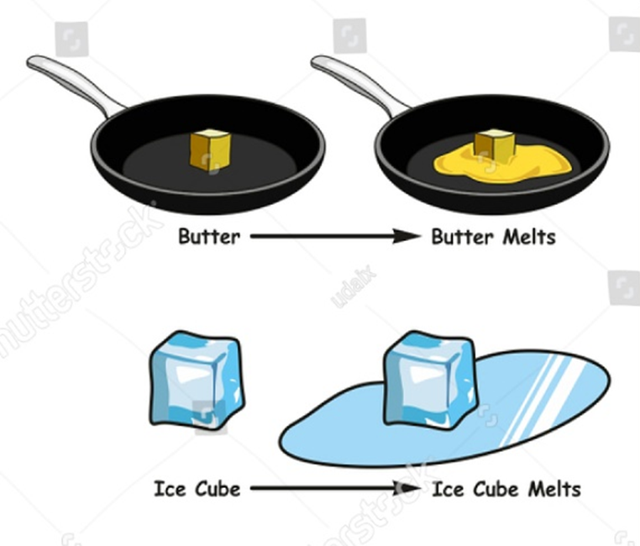
It means that the changes occurring in these activities can be reversed.
A reversible change is a change
In which we can get back the original substances we started the reaction with.

Slide 18
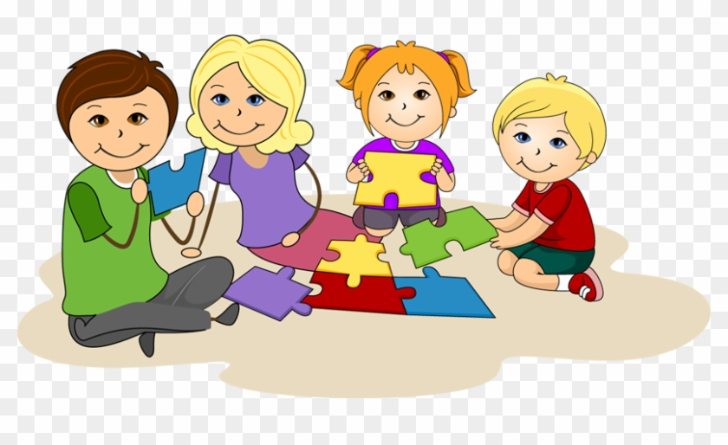
Now, let us repeat the same activities with a difference.

Slide 19
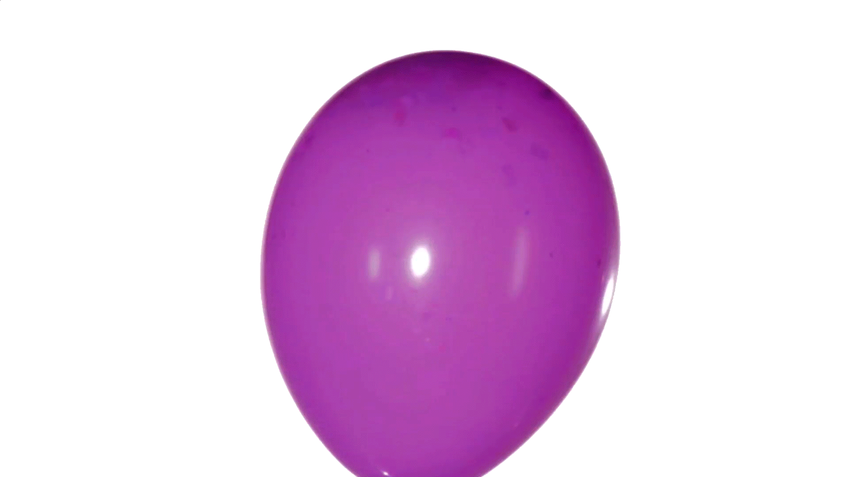
Blow the balloon to its full size and tie its mouth with a string tightly. Prick it with the pointed tip of your pencil. Oops! It burst.

Slide 20
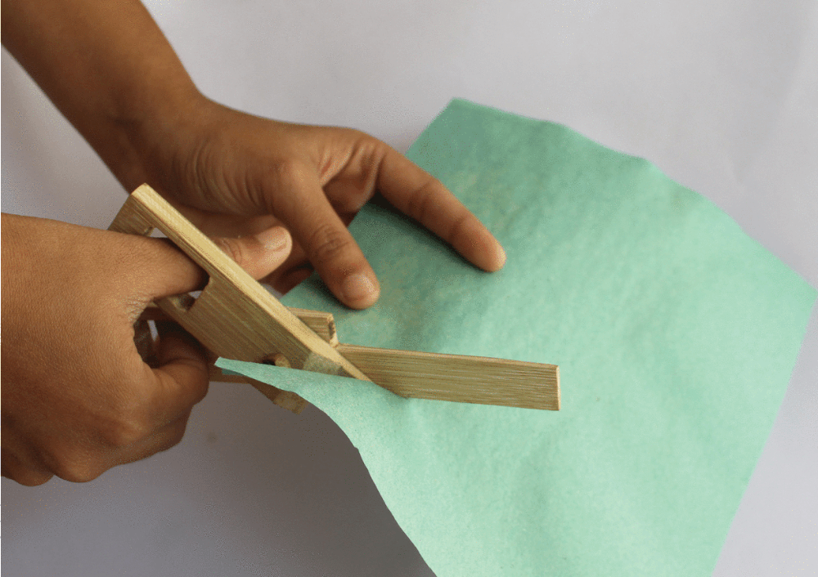
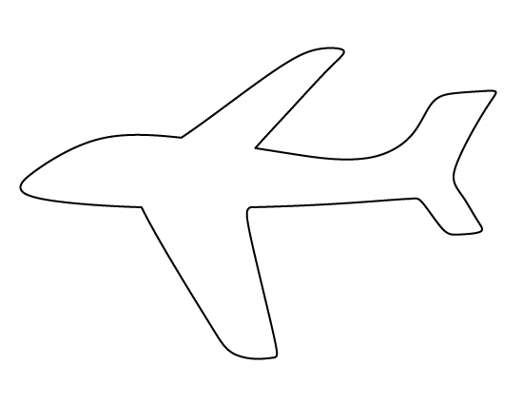
Take the same piece of paper, which you used in Activity 2. Draw an aeroplane on it and cut along its outline.

Slide 21
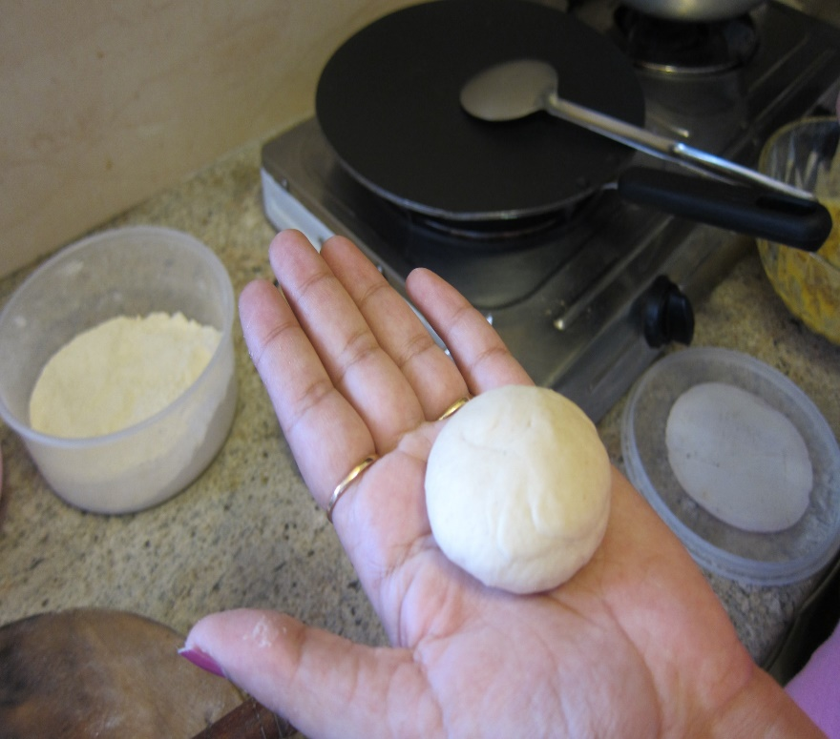
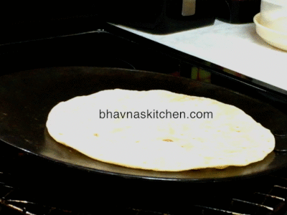
Roll out a roti from the ball of dough again and bake it

Slide 22
NOW ANSWER AGAIN
Was it possible to get the balloon back to its original shape and size?
Was the size of the paper same as before and after making an aeroplane ?
Was it possible to get back the ball of dough again?
NO !

Slide 23
It means that the changes occurring in these activities cannot be reversed.
An irreversible change is a change
In which we cannot get back the original substances we started the reaction with.

Slide 24
DIFFERENCE BETWEEN REVERSIBLE & IRREVERSIBLE CHANGES
Reversible changes | Irreversible changes
It can happen backward. | It cannot happen backward.
We can get back the original substance. | We cannot get back the original substance.
No new substance is formed. | New substance may be formed.
Condensation of steam ,melting of ice, rolling a roti etc. | Bud to flower, burning of fuel, spoiling of food etc.

Slide 25
Boiling of water
Answer: Reversible Change

Slide 26
Baking of pastries
Answer: Irreversible Change

Slide 27
Sawing of wood
Answer: Irreversible Change

Slide 28
Curling of
hair
Answer: Reversible Change

Slide 29
Spoiling of
food
Answer: Irreversible Change

Slide 30
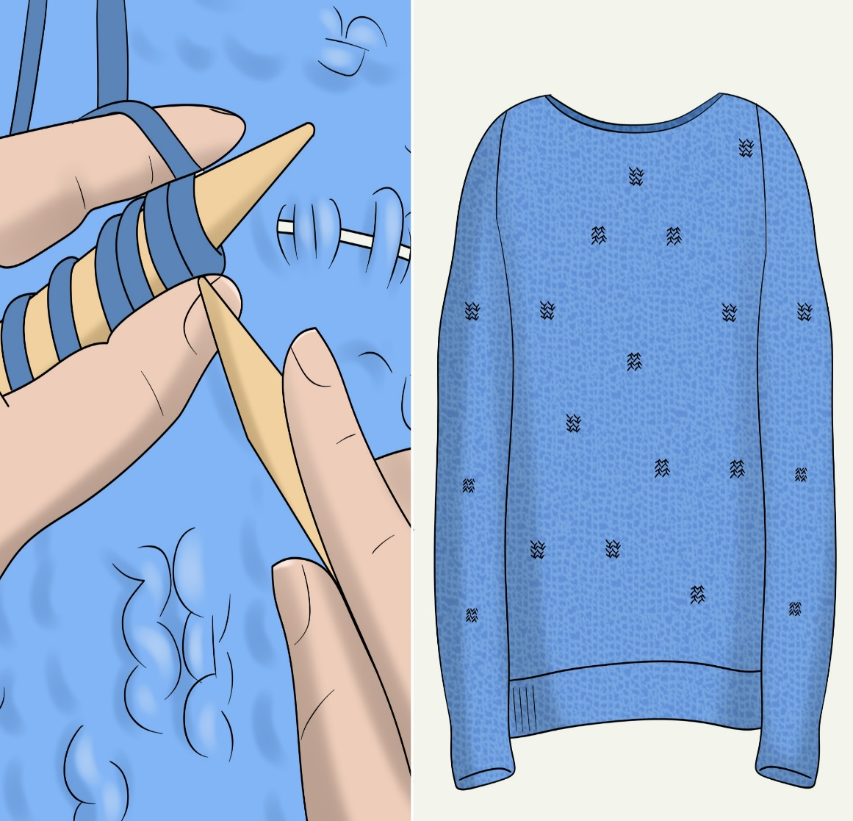
Knitting of sweater
Answer: Reversible Change

Slide 31
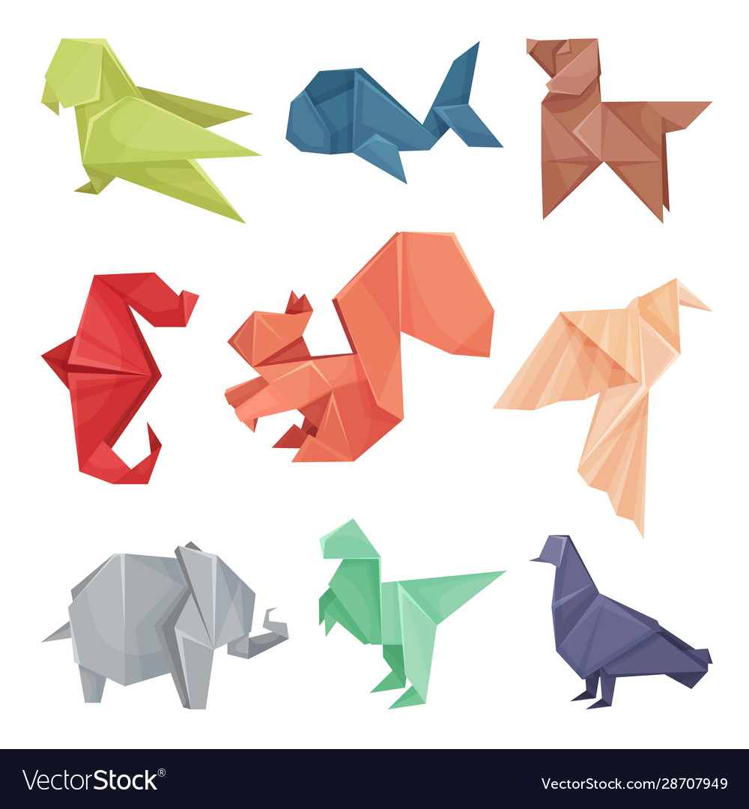
craftwork of paper folding
Answer: Reversible Change

Slide 32
Rusting of
nails
Answer: Irreversible Change

Slide 33
Pen & paper work
Directions: Copy and Answer.
Write R if it is a reversible change, and IR if it is an irreversible change. Write your answer in your notebook.

Slide 34
1.) melting of wax
2.) wilting of leaves of a plant
3.) burning of charcoal
4.) condensation of water vapour
5.) chewing of food

Slide 35
6.) decaying of human waste
7.) grinding of wheat
8.) cutting of grasses
9.) toasting of bread
10.) crumpling of paper

Slide 36
Assignment
Cut-out different pictures from old magazines or newspapers to find 5 examples each of reversible and irreversible Changes and paste them in your notebook.
To be continued……
●

